Slide 1
House Price Range Prediction
Empowering Future Homebuyers with Data-driven Insights
Durgesh Tiwari Rajendra kumar

Slide 2



Introduction
Predicting house price ranges is crucial for potential homebuyers as it assists them in effective budget planning and decision-making.
Our primary goal is to provide a tool that helps individuals planning to buy a house in the near future. By predicting price ranges based on historical data, we aim to support them in managing their budget effectively

Slide 3
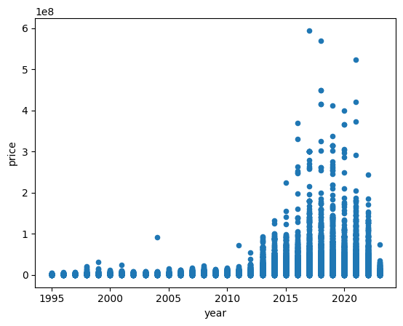
Data Collection
Total Records: | 28,276,227
Our dataset originates from Kaggle, specifically sourced from the UK Land Ministry and total data size in around 5GB and since data size was huge so we restrict to take data only from 2015 to 2023.
The significant challenge during data collection was the presence of numerous outliers and noise, necessitating their removal for process efficiency. We conducted exploratory data analysis (EDA) before proceeding further.
Flag | #
Low | 14,163,264
Medium | 8,035,969
High | 3,249,767
Very High | 2,793,163

Slide 4
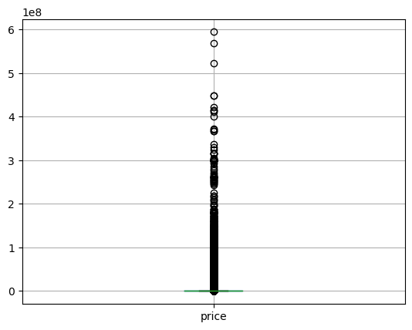
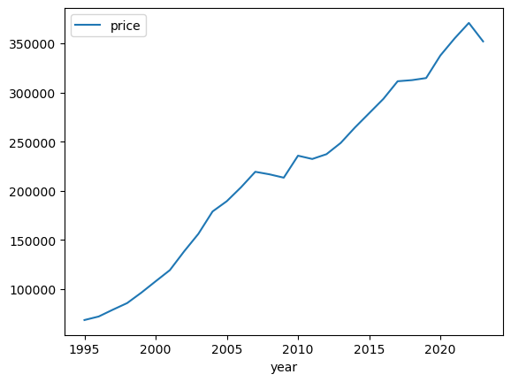
Exploratory Data Analysis (EDA)
Exploratory Data Analysis (EDA) was pivotal in comprehending and preparing our dataset for modeling, encompassing outlier detection, null value handling, and efficient data type adjustment.
To enhance efficiency, we optimized data storage by converting it to the Parquet format, ensuring streamlined processing for subsequent analyses.
Leveraging diverse visualizations like scatter plots, box plots, and density plots during EDA provided nuanced insights, aiding in a comprehensive understanding of the data's characteristics.
There is a little dip we can clearly observe during the recession 2008-2009 and during the COVID hit.

Slide 5
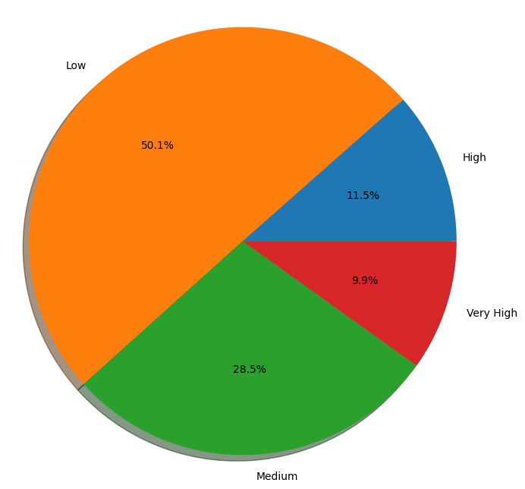
Data Categorization
Categorizing our data is pivotal for achieving our project goals and extracting meaningful patterns.
We employed label encoding, frequency encoding, and one-hot encoding to effectively categorize our dataset.
When we consider entire data, there is 50% concentration in the Low category as during 1990-2010 there is clear indication that the housing prices were lower.

Slide 6
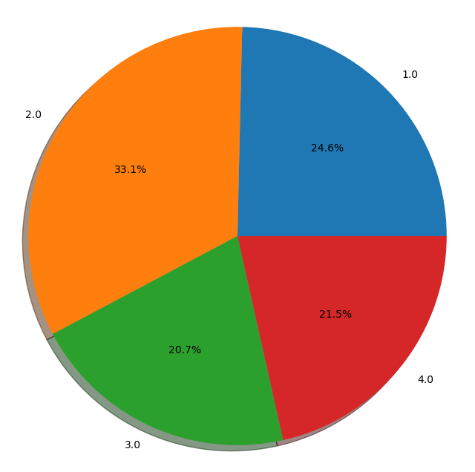
Data reduction:
Restricted data from year 2015 to 2023 and reduced the shape of the data frame.
At early stage, the classes were imbalanced, after reduction we can observe the that data is mostly normally distributed.
Flag categories are manual ordinal encoded with below values.
Flag | Encode | #
Low | 1 | 1,121,452
Medium | 2 | 1,658,093
High | 3 | 1,120,822
Very High | 4 | 1,217,471

Slide 7
Implementation Process
Features and encoding techniques:
Attributes | Data types | Defination | Encoding Technique
Transaction_unique_identifier | object | Unique transaction number | Not using for model
price | int64 | The price for which the property was sold | Not using for model
Date_of_Transfer | datetime64[ns] | Date of the house ownership transfer. | Derived year
Property_Type | object | The type of property. | One Hot Encoding
Old/New | object | Indicates if the house is old or new. | One Hot Encoding
Duration | object | The duration of the house built | One Hot Encoding
PAON | object | (Primary Addressable Object Name) | Label Encoding
SAON | object | (Secondary Addressable Object Name) | Label Encoding
Street | object | Street name where property is located. | Label Encoding
Locality | object | Additional locality information | Label Encoding
Town/City | object | Town or city where property is located | Label Encoding
District | object | The district in which the property resides | Label Encoding
County | object | The county where the property is located | Label Encoding
year | int64 | Year of the house transfer. | Numeric Attribute
Flag | object | Derived from amount paid for house. | ordinal encoding
Utilized label encoding, frequency encoding, and one-hot encoding in the encoding process to extract meaningful patterns from the data, crucial for optimizing model training effectiveness.
Opted for Random Forest and XGBoost algorithms during implementation, recognizing their effectiveness in regression tasks, ensuring a robust foundation for the modeling phase.

Slide 8
Model Training and Evaluation
Briefly presented Random Forest and XGBoost algorithms, the chosen foundation for our project, highlighting their significance in the modeling phase.
Conducted comprehensive training sessions for our models using the meticulously prepared dataset, ensuring they were well-equipped for subsequent tasks.
Utilized metrics like to quantitatively assess model performance, revealing promising results and providing insights into their effectiveness.

Slide 9
Performance Evaluation:
Algorithms | Accuracy | Precision | Recall | F1
Logistic Regression | 61.13 | - | -
Random Forest | 79.97 | 77.38 | 78.26 | 77.81
XGBoost | 73.21 | 71.37 | 69.17 | 70.52

Slide 10
Impediments:
Primary challenge encountered was the requirement for substantial computational resources.
Dataset comprised 5GB, encompassing 300 million records across 16 columns or features.
The data included numerous categorical features, as well as features derived from existing ones.
Identifying and handling extreme outliers and missing values proved to be a costly process.
Variations in data were noted, which could be attributed to economic recession and the impact of COVID-19.
A key consideration was determining appropriate encoding techniques for the various features.
The sheer volume of the data presented difficulties in conducting an effective Exploratory Data Analysis (EDA).

Slide 11
Future Implementations
Future efforts will focus on refining the model to achieve even closer predictions of house price ranges, aiming for increased accuracy and precision in forecasting.
We see our model helping individuals in property investment by providing valuable insights for smarter decision-making in this area.

Slide 12
Conclusion
Our focus is on refining the model to predict house price ranges more accurately, aiming for improved precision in our forecasts.
Looking beyond house price prediction, we plan to extend the model's utility to diverse domains and applications, exploring its adaptability and effectiveness in varied contexts.

Slide 13

Q & A

Slide 14

Thank you

